Slide 1


Food sales predictions
Jacob L. Vaughn
Notes:
Greetings, this is a presentation of food sales predictions by Jacob L. Vaughn.

Slide 2
Food Sales Predictions
Analyzed and interpreted a random dataset to predict future sales
Isolated the food sales variable
Use graphs to compare both internal and external factors to determine a pattern of customer purchasing behavior
Two models fit onto dataset to predict sales
Linear Regression Model
Decision Tree Model
Linear regression model was a better predicter
Use of this model is recommended
Moving forward, would recommend more data be gathered pertaining to the item purchases, the reasons purchased, and other external factors that could be better to predict future sales
Notes:
In this study, a dataset containing food sales, item type, item identifiers, item weight, item visibility, and other factors was analyzed to predict food sales. The food sales variable was isolated allowing external factors to be compared against one another to determine a pattern of customer purchasing behavior. This involved comparing item type to its overall weight, which was then measured against the total percentage sold within the dataset. Following the comparison, a linear regression and decision tree model was fit onto the dataset to predict sales. The linear regression model was more accurate during the testing and evaluation phase leading to the recommendation to use the model instead of the decision tree model.

Slide 3
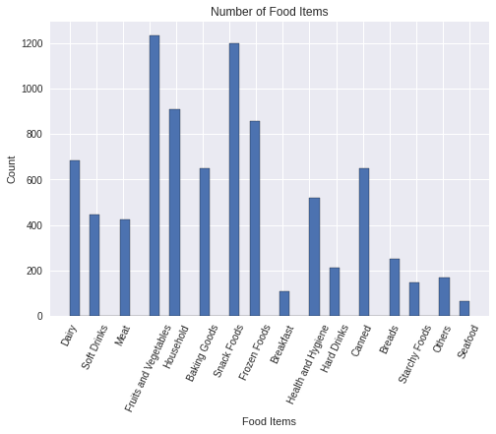
Number of Food Items
Fruits and Vegetables rank #1, followed by Snack Foods, and household items
Large gap between top, middle, and bottom values
Prompts questions concerning why items are sold in larger quantities
Notes:
This bar graph shows the total count of each food item, in a respective category, sold across various types of grocery stores and/or markets. Fruits and vegetables had the highest quantity sold with snack foods in second, followed by household items and then frozen foods. There is a significant difference between the number of items sold among the top tier, middle tier, and lower tier. This could be due to the item’s shelf life, the time it takes for the item to expire, how visible the item is within the store, or another unexpected external factor.

Slide 4
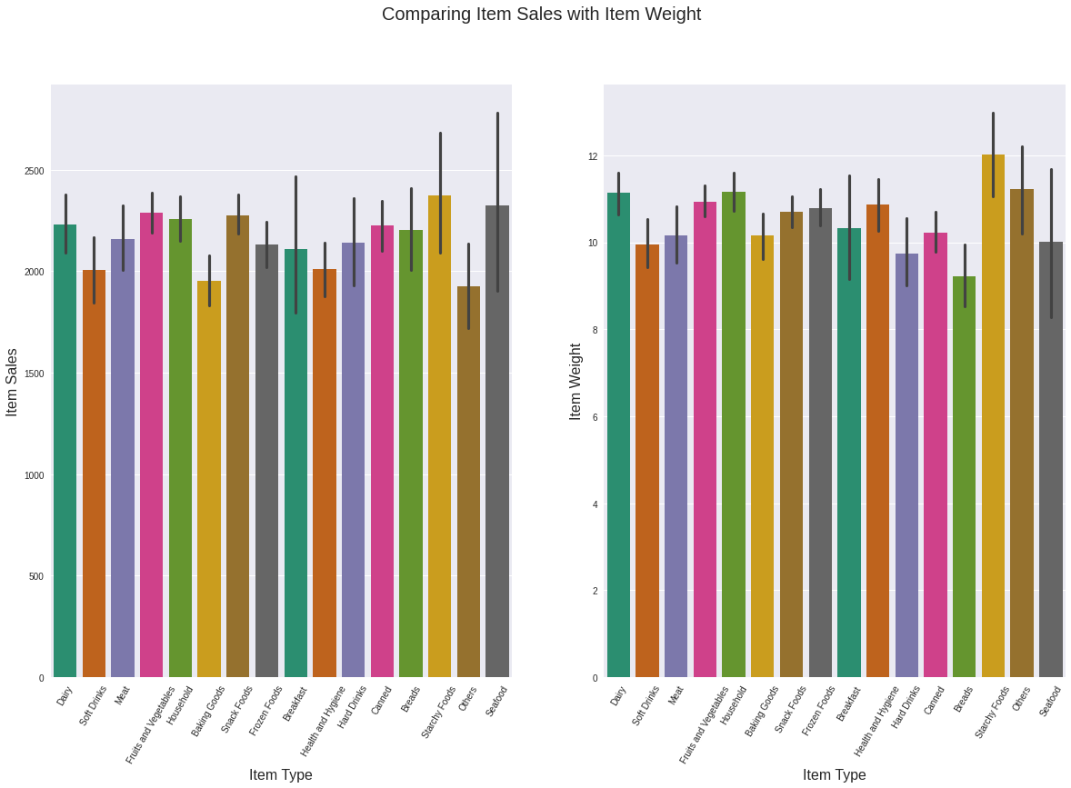
Comparing Item Sales with Item Weight
Item sales is not directly affected by item weight
Item sales have a higher outlier range
Item weight remains relatively consistent within item type
Notes:
These bar graphs are comparing the item sales to the item weight of each item type. There is not a significant difference, collectively, to suggest that item weight either positively or negatively affects the sales of an item type. The middle line in each bar indicates the potential outlier range. This does indicate that there are stores that have a larger number of sales outside of the collective while the weight of the item type does not vary as often.

Slide 5
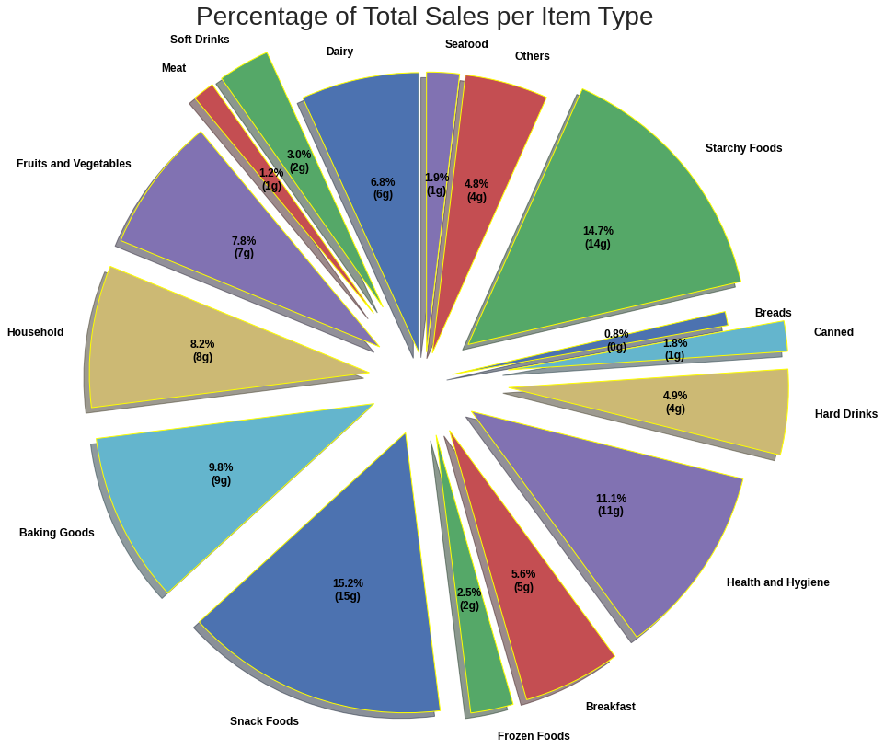
Percentage of Total Sales per Item Type
Pie chart displays percentage of total sales per item type
Snack foods accounts for highest percentage
Notes:
Using this pie chart, the percentage of total sales per item type can be measured and compared. Snack foods account for the highest percentage, which is accurate based on the two previous graphs, where snack foods ranked within the top five. In a close second is starchy foods that comes as a surprise based on the first bar graph presented earlier in the slide show, however, this is accurately reflected in the side-by-side graph comparison. Health and hygiene ranks as third with baking goods in a close fourth rank. This chart further undergirds the need for more information to be gathered about the customer’s needs, purchase reasons, etc. to better predict sales.

Slide 6
Conclusion
Use a linear regression model to predict food sales
Visuals suggest food sales are dependent on unknown, independent factor(s)
Gathering data on customers’ purchase reasons is recommended for future studies
Notes:
In conclusion, the graphs suggest that there is an external factor guiding customers’ purchases, whether this is an item’s shelf life, item necessity, or personal preference. It is encouraged to gather more customer relevant data on purchase behaviors to better predict food or item sales. With the current dataset, it is advised that a linear regression model be used in predicting food sales instead of a decision tree model.

